Slide 1
DIRECT AND INDIRECT

Slide 2
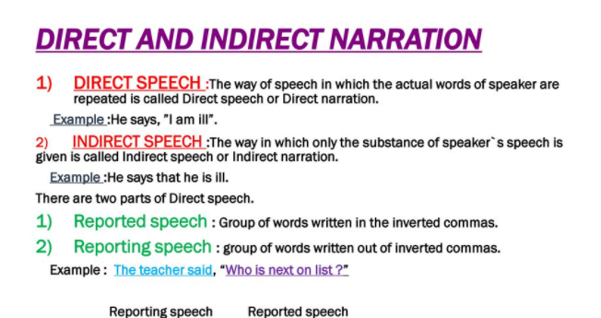

Slide 3
Poll question
Which is a reporting verb?
tell
go
be

Slide 4
Which is a reporting verb?
tell
go
be

Slide 5
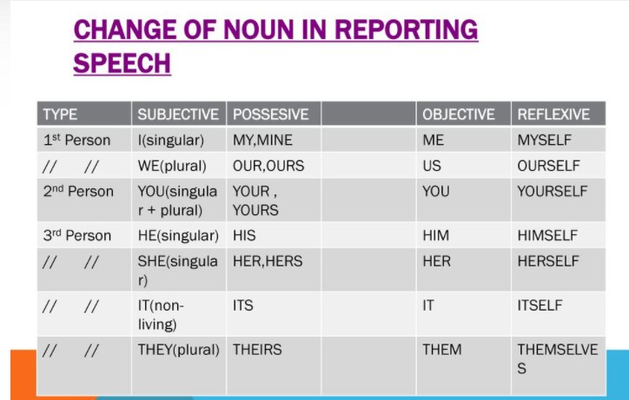

Slide 6
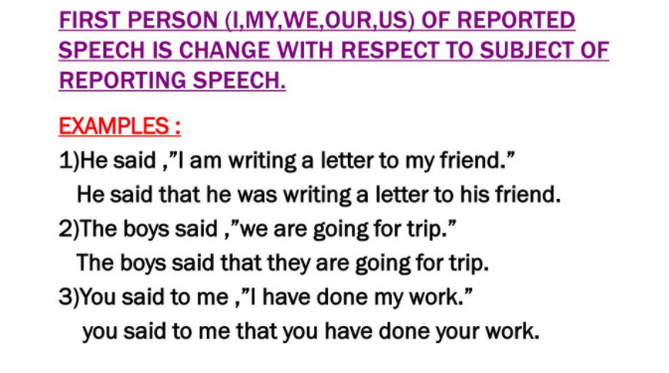

Slide 7
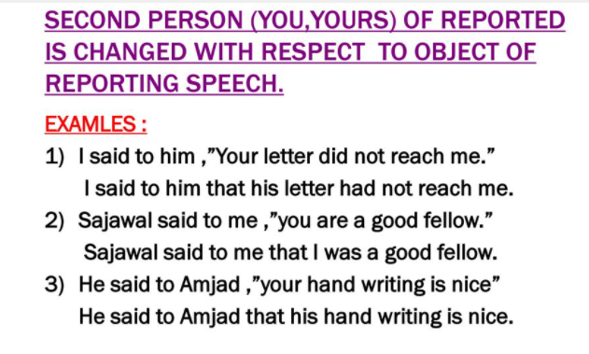

Slide 8
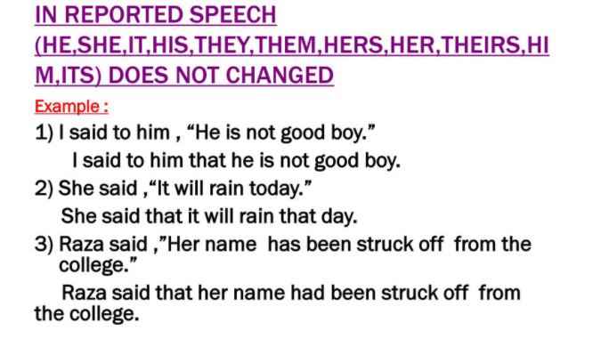

Slide 9
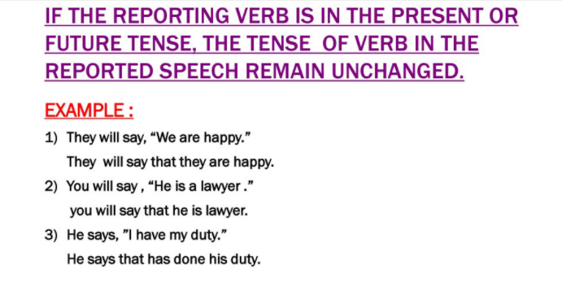

Slide 10
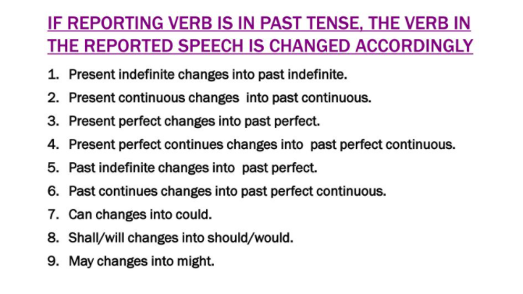

Slide 11
Poll question
You said, "It gives me great pleasure to be with my friend, we have great time ever."
You said that it gave him great pleasure to be with his friend we had great time ever.
You said that it gave you great pleasure to be with your friend you had great time ever.
You said it gives me great pleasure to be with my friend we have great time ever.
You said that it has given you great pleasure to be with your friend you have great time ever.

Slide 12
You said, "It gives me great pleasure to be with my friend, we have great time ever."
You said that it gave him great pleasure to be with his friend we had great time ever.
You said that it gave you great pleasure to be with your friend you had great time ever.
You said it gives me great pleasure to be with my friend we have great time ever.
You said that it has given you great pleasure to be with your friend you have great time ever.

Slide 13
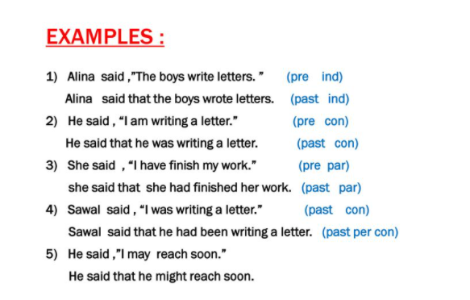

Slide 14
Poll question
She said, "If you work hard, you will take good marks."
My teacher advised if I work hard I could take good marks.
My teacher advises if you work hard you will take good marks.
My teacher advises if I work hard I will take good marks.
My teacher advised that I worked hard I would take good marks.

Slide 15
She said, "If you work hard, you will take good marks."
My teacher advised if I work hard I could take good marks.
My teacher advises if you work hard you will take good marks.
My teacher advises if I work hard I will take good marks.
My teacher advised that I worked hard I would take good marks.

Slide 16
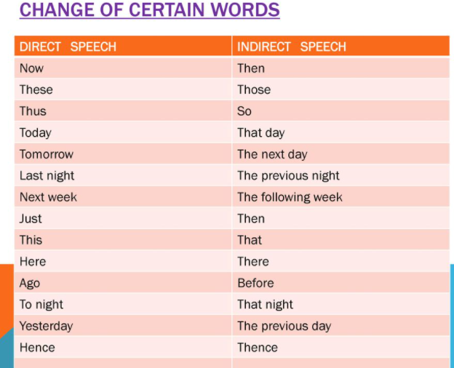

Slide 17
Poll question
Principal says, "Is the librarian present today?"
Principal said that if the librarian was present that day.
Principal asks if the librarian is present that day.
Principal asks if the librarian was present that day.
Principal is asked if the librarian present that day.

Slide 18
Principal says, "Is the librarian present today?"
Principal said that if the librarian was present that day.
Principal asks if the librarian is present that day.
Principal asks if the librarian was present that day.
Principal is asked if the librarian present that day.

Slide 19
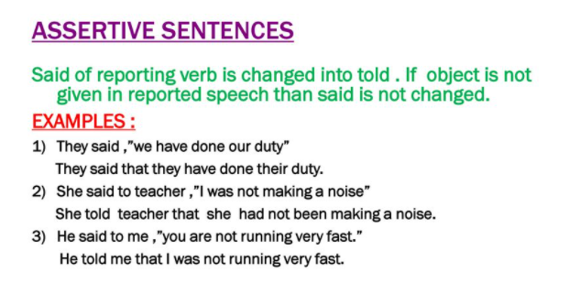

Slide 20
Poll question
Mother said to child, "You must do your homework, after that you can go for playing."
Mother asked to child that he must did his homework after that he could go for playing.
Mother said to child that he must done his homework after that he could be go for playing.
Mother was requested to the child that he does his homework after that he can go for playing.
Mother is ordered to the child that he did his homework after that he can gone for playing.

Slide 21
Mother said to child, "You must do your homework, after that you can go for playing."
Mother asked to child that he must did his homework after that he could go for playing.
Mother said to child that he must done his homework after that he could be go for playing.
Mother was requested to the child that he does his homework after that he can go for playing.
Mother is ordered to the child that he did his homework after that he can gone for playing.

Slide 22
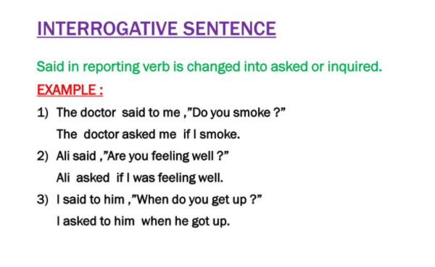

Slide 23
Poll question
He said to the teacher, "May I ask a question?"
He said to the teacher that he may ask a question.
He asks to the teacher that may he ask question.
He asked the teacher that he might ask a question.
He asked to the teacher that he might be ask a question.

Slide 24
He said to the teacher, "May I ask a question?"
He said to the teacher that he may ask a question.
He asks to the teacher that may he ask question.
He asked the teacher that he might ask a question.
He asked to the teacher that he might be ask a question.

Slide 25
Poll question
A nurse said, "He is sleeping, please do not disturb him."
A nurse informed that he was sleeping requested not to disturb him.
A nurse said that he slept requested do not disturb him.
A nurse informed that he had sleeping requested did not disturb him.
A nurse said that he is sleeping requested do not disturb him.

Slide 26
A nurse said, "He is sleeping, please do not disturb him."
A nurse informed that he was sleeping requested not to disturb him.
A nurse said that he slept requested do not disturb him.
A nurse informed that he had sleeping requested did not disturb him.
A nurse said that he is sleeping requested do not disturb him.

Slide 27
Poll question
They said, "We really enjoyed a movie, we have never seen such a movie in a life."
They said that they really had enjoyed a movie they had never seen such a movie in a life.
They said that they really enjoyed a movie, they never saw such a movie in a life.
They said that they really had enjoyed a movie they have never seen such a movie in a life.
They said that we really had enjoyed a movie we had never seen such a movie in a life.

Slide 28
They said, "We really enjoyed a movie, we have never seen such a movie in a life."
They said that they really had enjoyed a movie they had never seen such a movie in a life.
They said that they really enjoyed a movie, they never saw such a movie in a life.
They said that they really had enjoyed a movie they have never seen such a movie in a life.
They said that we really had enjoyed a movie we had never seen such a movie in a life.

Slide 29
Poll question
Student said to the teacher, "Please give me one day leave, I have a fever."
Student requested to the teacher to give him one day leave he had a fever.
Student request to the teacher to gave him one day leave he had a fever.
Student requested to the teacher to give me one day leave i have a fever.
Students asks to the teacher to give me one day leave i had a fever.

Slide 30
Student said to the teacher, "Please give me one day leave, I have a fever."
Student requested to the teacher to give him one day leave he had a fever.
Student request to the teacher to gave him one day leave he had a fever.
Student requested to the teacher to give me one day leave i have a fever.
Students asks to the teacher to give me one day leave i had a fever.

